Slide 1
Survey of Algorithms
DSGT
Materials: https://bit.ly/2mdzyYY
Check in: http://bit.ly/2nUgwYc
093019

Slide 2
Goals
Learn:
What is a model?
Intuition, decision boundaries, formulation
How do we train one?
Parameters, hyperparameters
When do we use which?
Put it all together through coding examples!
Notes:
http://sleep.csail.mit.edu/

Slide 3
Three Ways to Consider
Models and Computation
Picture Representation
Decision Boundaries
Mathematical Formulation

Slide 4
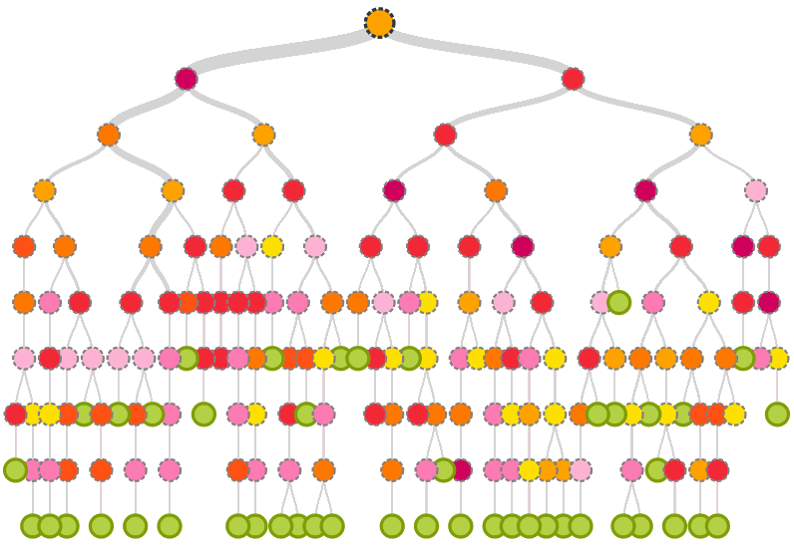
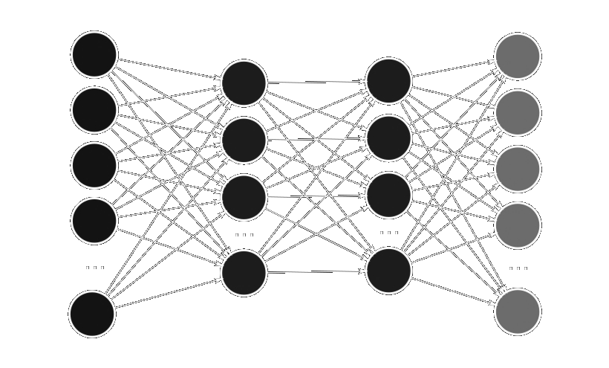
1) Pictorial Representations

Slide 5
2) Decision Boundaries
SVM
Decision Tree
Neural Network
Notes:
Mention linear and nonlinear

Slide 6
3) Math Formulation
Discover a mapping function representing input output relationships
Example:
y = f(x) + e
f: X → Y

Slide 7

3) Math Formulation
Discover a mapping function representing input output relationships
Example:
y = f(x) + e
f: X → Y
f: X → Y
Image → Label
Jellyfish

Slide 8

Parameters
Parameters

Slide 9
Parameters
Parameters
x₁ | x_{1,2}
x₂ | x_{2,2}
x₃ | x_{3,2}
y₁
y₂
y₃
θ₁
θ₂
=

Slide 10



Slide 11


Slide 12
Hyperparameters
KRR = KernelRidge(alpha=.003, kernel='rbf', gamma=.1)
KRR.fit(X_train, y_train)
mlp = MLPClassifier(activation='relu', momentum='.8', learning_rate_init=.002)
mlp.fit(x_train,y_train)

Slide 13
Schematic
Model
Reinforcement
Supervised
Unsupervised
Dimensionality Reduction
Clustering
Classification
Regression
KNN
SVM
NN
...
DT
Linear
Polynomial
Kernel Ridge
...
DT
K-Means
Agglomerative
...
DBSCAN
PCA
LDA
Regularization (LASSO)
...
Forward Selection

Slide 14




Classification v. Regression
$200,000
Spam
9.5/10
Bear

Slide 15
Clustering
 | Feature | Feature | Feature
Expt | 2342.23 | 674.56 | 11234.5
Expt | 1234.13 | 3423.5 | 256.23
Expt | 123.53 | 954.3 | 2345.5
Expt | 43345.3 | 847.34 | 763.432
Expt | 34598.5 | 845.5 | 4365.4
Expt | 8564.3 | 743.2 | 9765.3
Expt | 54634.3 | 1345.3 | 98623.4
Regression
Clustering

Slide 16
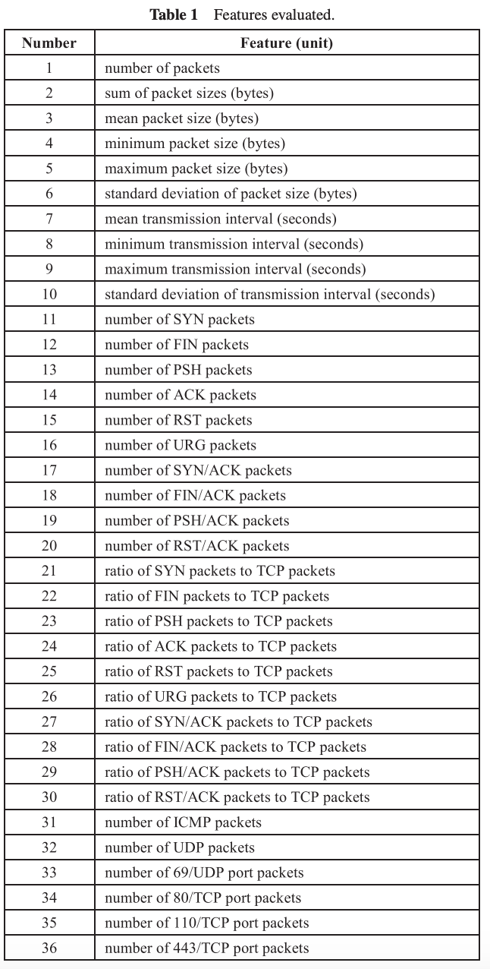
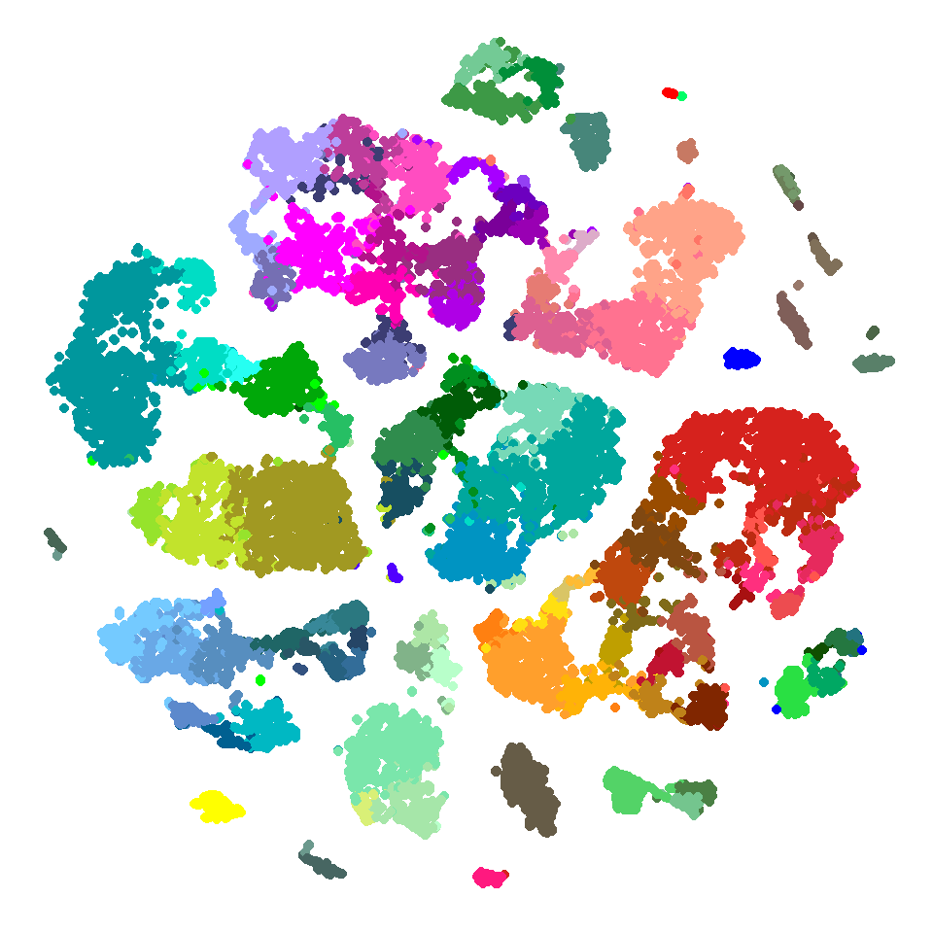
Dimensionality Reduction

Slide 17
Classification

Slide 18
SVM
Hyperplane
Maximum Margin
Multidimensional
Kernel for nonlinearity

Slide 19
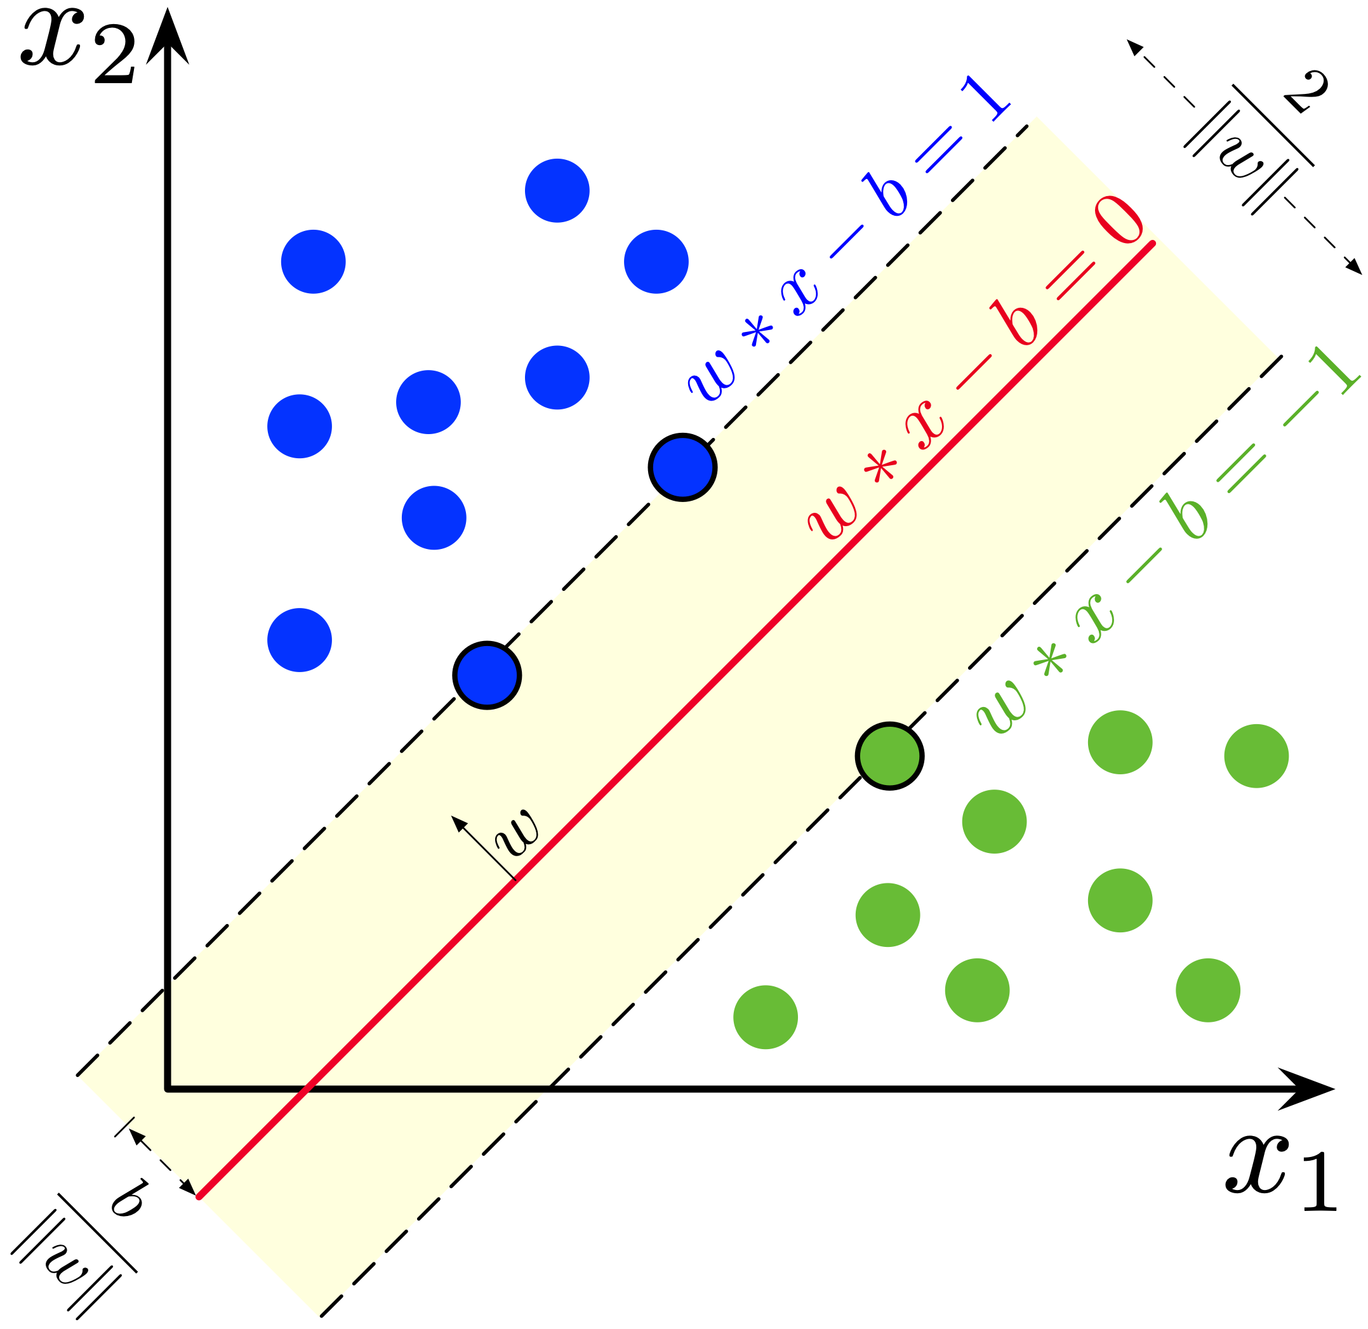
SVM
Hyperplane
Maximum Margin
Multidimensional
Kernel for nonlinearity

Slide 20
Decision Tree

Slide 21
Decision Tree
Leafs, branches
Information Gain

Slide 22
Feed-Forward Neural Net
Forward Propagation
Weights/Biases
Activations
Nonlinear

Slide 23
Logistic Regression
1
0
Probability
Logit Function
Binary Classifier

Slide 24
Logistic Regression
1
0
Probability
Logit Function
Binary Classifier

Slide 25
Regression

Slide 26
Intuition
?
How can we fit this data to make a prediction?

Slide 27

Linear vs Polynomial

Slide 28
A Deeper Dive
See Coding Notebook
More info and examples!
Linear
Polynomial
Decision Tree

Slide 29
Clustering

Slide 30
See old clustering workshop!

Slide 31
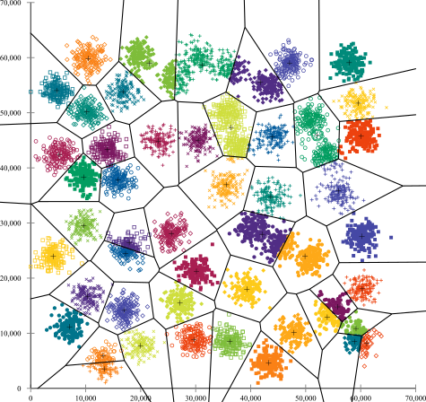
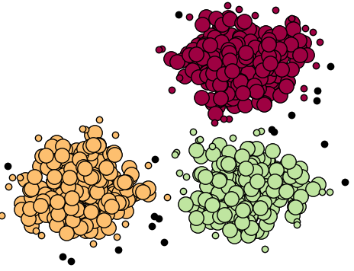
Reminder: K-Means

Slide 32
Reminder: Agglomerative

Slide 33
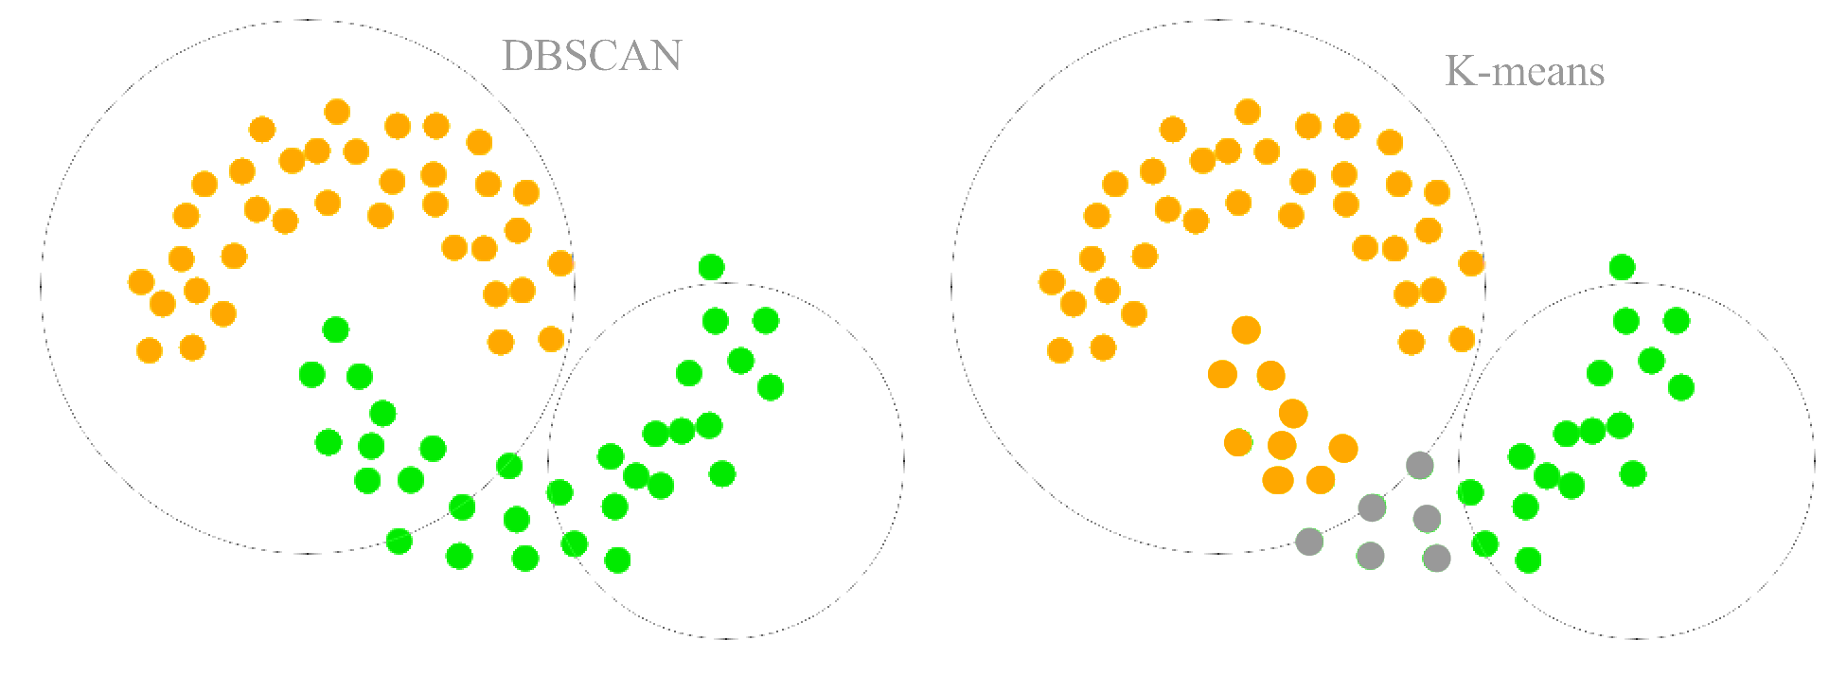
Reminder: Density-Based
Noise
Core
Border

Slide 34
Dimensionality Reduction

Slide 35
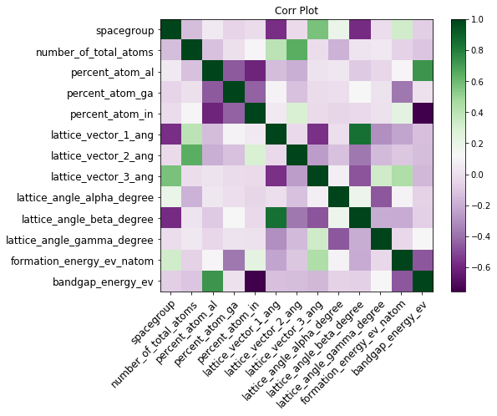
Using Correlations

Slide 36
Forward Feature Selection
Steps:
Iterate through all features
Select most informative feature
Keep it
Iterate through all other features
Select best compliment
Iterate through remaining features
Select best compliment
Terminate at threshold

Slide 37
Forward Feature Selection
Steps:
Iterate through all features
Select most informative feature
Keep it
Iterate through all other features
Select best compliment
Iterate through remaining features
Select best compliment
Terminate at threshold
2
R

Slide 38
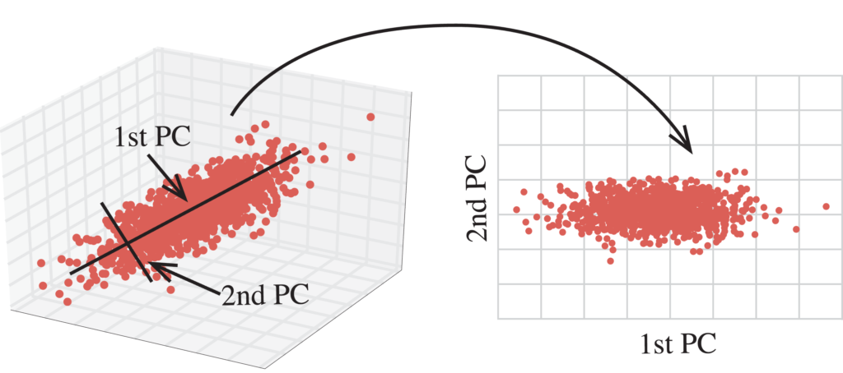
PCA
Intuition
Too many features!
Use variance to…
Redefine our axis!
New coordinate system

Slide 39
Questions?

